Slide 1
DQL & API
Notes:
Place the audio notes for this slide here

Slide 2

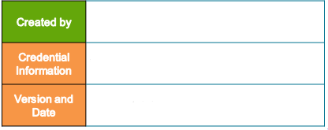
Varun Rajendran (360594)
Enterprise Content Management Competency
V 0.3, 19th March 2018

Slide 3

DQL
  Introduction to DQL
  Repository Infrastructure
  DQL Statements
  DQL Elements (Building Blocks of DQL)
  WHERE clause in DQL
  DQL related to Registered Table
  Hands On
API
  Introduction to API
  API Tester
  API Methods
  Hands On
Utilities
Tools
References

Slide 4
Introduction to DQL

Slide 5
Introduction to DQL
DQL is the acronym for Document Query Language.
The Syntax of DQL is similar to SQL, which is used to query information from Documentum repository.
SQL statements only operate on tables\rows
Unlike SQL, DQL statements operate on objects and sometimes on tables\rows
By using DQL, can access registered tables - tables in the underlying RDBMS that are known to Content Server but that are not part of the repository.

Slide 6
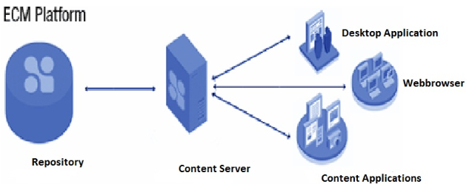
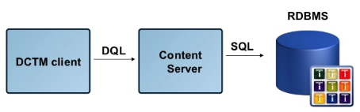
Repository Infrastructure
Content Server translates DQL to SQL.
SQL is passed to the RDBMS which searches underlying type tables.
The Content Server searches for the objects of the type selected and all of its subtypes and returns the result to the client application

Slide 7
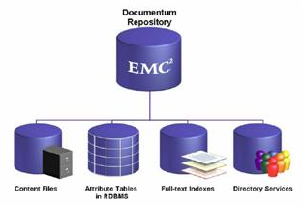
DQL Statements
The basic DQL query statements retrieve information about the objects in a repository and manipulate those objects.
Basic query statements in DQL are :
SELECT
UPDATE
INSERT
DELETE

Slide 8
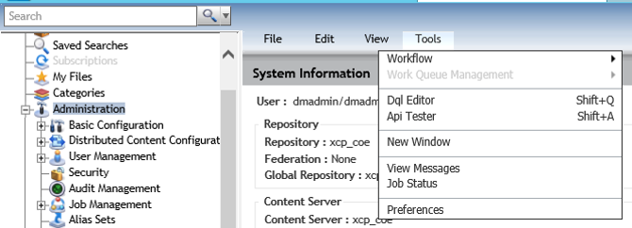
DQL Editor in DA

Slide 9
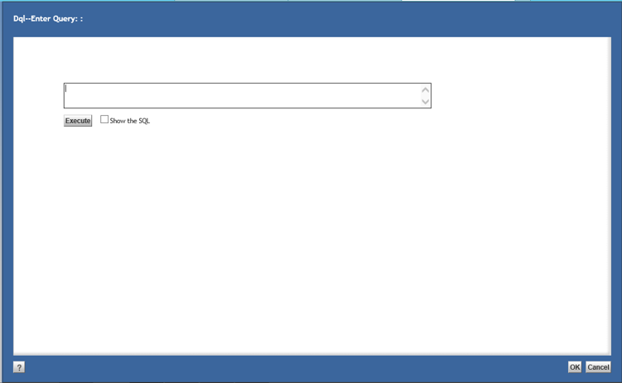
DQL Editor

Slide 10
SELECT Statement
The SELECT statement is the primary query statement, fetches the information from the repository.
SELECT statements are not only stand-alone statements but are also used in other DQL statements (As sub-queries).
In SELECT Statement, you specify object properties in the select clause and an object type in the from clause.
Types of DQL SELECT statement :
Standard Select : It retrieves wide variety of information from the repository.
FTDQL select statement : FTDQL queries are run entirely against the full text index, which improves performance.

Slide 11
Syntax of SELECT Statement :
  Standard SELECT Statement:
  SELECT [FOR base_permit_level][ALL|DISTINCT] value [AS name] {,value [AS name]}
  FROM [PUBLIC] source_list [WITHIN PARTITION (partition_id{,partition_id})| IN DOCUMENT clause
  | IN ASSEMBLY clause][SEARCH [FIRST|LAST]fulltext_search_condition[IN FTINDEX index_name{,index_name}]
  [WHERE qualification][GROUP BY value_list][HAVING qualification][UNION dql_subselect][ORDER BY value_list]
  [ENABLE (hint_list)]
FTDQL SELECT Statement
  SELECT [FOR base_permit_level] [ALL|DISTINCT] value [AS name] {,value [AS name]} FROM [PUBLIC] source_list [SEARCH fulltext_search_condition [IN FTINDEX index_name{,index_name}] [WHERE qualification] [ORDER BY SCORE] [ENABLE (hint_list)]

Slide 12
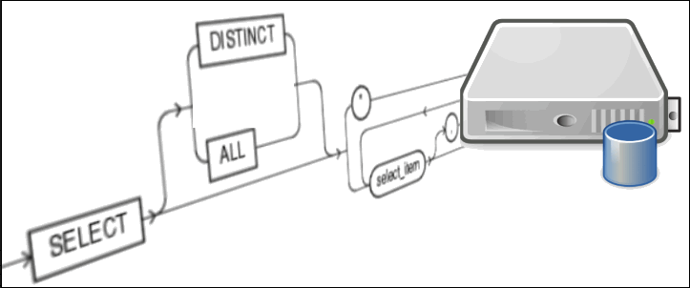
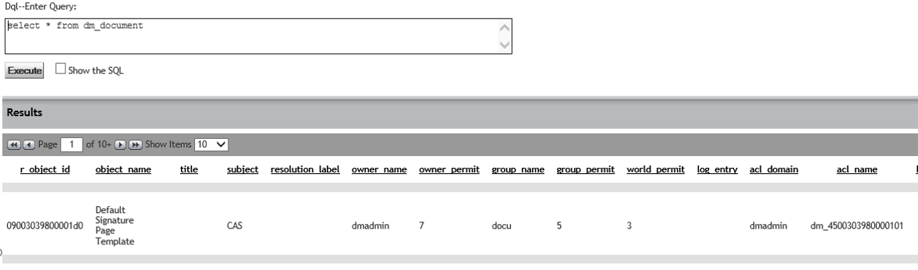
[all | distinct]
  all (default) returns all rows, including duplicates
  distinct provides unique results
Value(s)
  usually represents properties
  A scalar, aggregate, arithmetic function or keywords.
Source_list
  It refers to object types or registered tables.

Slide 13
UPDATE Statement
The UPDATE statement changes the RDBMS table that underlies a registered table.
The UPDATE...OBJECT[S] statement modifies objects in the repository. Using this statement, you can:
  Set values of a single valued property
  Insert/ remove values in a repeating property
  Link / unlink object to a folder.
  Move an object to a new folder.

Slide 14
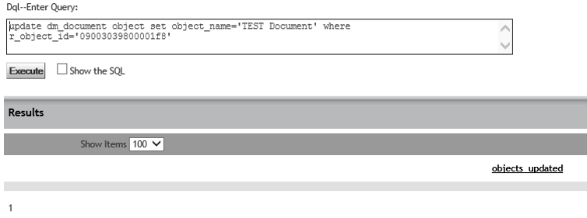
UPDATE Statement
  Syntax:
  UPDATE table_name SET column_assignments WHERE qualification

Slide 15
INSERT Statement
The INSERT statement adds a row to the RDBMS table that underlies a registered table.
Syntax:
INSERT INTO table_name [(column_name {,column_name})] VALUES (value {,value}) | dql_subselect

Slide 16
DELETE Statement
The DELETE statement destroys rows in the RDBMS table that underlies a registered table.
The DELETE...OBJECT[S] statement deletes objects from the repository.
Syntax:
DELETE FROM table_name WHERE qualification
Delete…Object
DELETE [PUBLIC]type_name[(ALL)] [correlation_variable] [WITHIN PARTITION (partition_id {,partition_id}) OBJECT[S] [IN ASSEMBLY document_id [VERSION version_label] [NODE component_id][DESCEND]] [SEARCH fulltext search condition] [WHERE qualification]

Slide 17
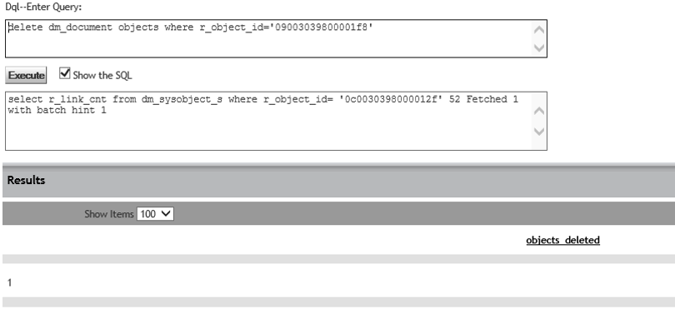

DELETE Statement
.

Slide 18
DQL Elements
Below are the building blocks of DQL Statement
  Literals
  Special Keywords
  Functions
  Predicates
  Logical Operators
Literals
  Literals are values that are interpreted by the server exactly as they are entered. Content Server recognizes five types of literals:
  Integer Literals : It specifies a whole number between 0 to 2147483647. DQL doesn’t support negative integer value.
  Floating point Literals : A floating point literal specifies any number that contains a decimal point [Ex : 3.57]
  Character String Literals : Character string literals are strings of printable characters and are enclosed in single quotes.

Slide 19
  ID Literals : An ID literal specifies an object ID as a 16-character string enclosed in single quotes. ID refers r_object_id of an object.
  Date literals : A date literal specifies a date using the following syntax:
    DATE('date_value[utc]' [,'pattern'])
  date_value can be defined using any of the valid character string formats representing a date, or it can be one of the keywords that represent dates.
  Valid format/dates range from 01/01/1753 (January 1, 1753) to 12/31/4712 (December 31, 4712).
  Date literal keywords:
  Four keywords represent dates:
  TODAY
  NOW
  YESTERDAY
  TOMORROW

Slide 20
Special Keywords
DQL includes some special keywords for use in queries.
These keywords have special meanings for Content Server when used in a DQL query. The keywords are:
  USER : It refers current logged in user
    SELECT process_id, object_name FROM dm_workflow
    WHERE supervisor_name=USER
  TRUE and FALSE : It represent the Boolean true and false.
    SELECT * FROM dm_user WHERE r_is_group = TRUE
  DM_SESSION_DD_LOCALE : It represents the data dictionary locale most appropriate for the client’s session locale.

Slide 21
Functions
Scalar Functions - Scalar functions operate on one value and return one value.
  The scalar functions are:
• ASCII - The ASCII function takes one argument and returns the ASCII code value of the first character of the argument.
      • BITAND
      • BITCLR
      • BITSET
      • UPPER - The UPPER function takes one argument and returns the uppercase of that value.
      • LOWER - The LOWER function takes one argument and returns the lowercase of that value.
      • SUBSTR - The SUBSTR function returns some or all of a particular string
BITAND, BITCLR, and BITSET can appear in the WHERE clause of the DELETE,SELECT, and UPDATE DQL statements

Slide 22
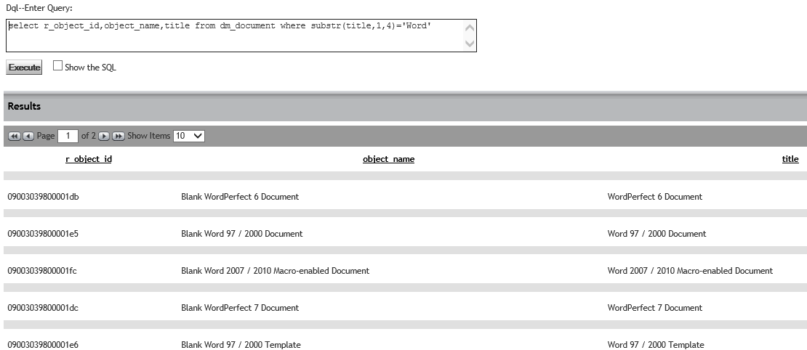

Slide 23
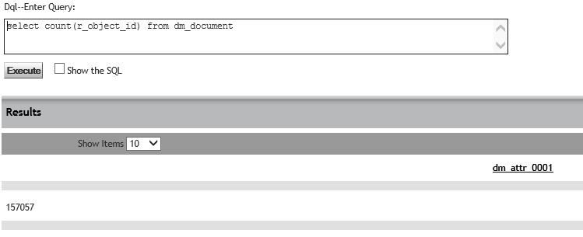
Aggregate Functions
      The five aggregate functions are:
      • COUNT - The COUNT function counts values.
      • MIN - The MIN function returns the minimum value in a given set of values.
      • MAX - The MAX function returns the maximum value in a given set of values.
      • AVG - The AVG function returns an average.
      • SUM - The SUM function returns a total.

Slide 24
Date Functions
The Six Date Functions are:
    DATEDIFF – It represents the difference between the two dates
    DATEADD – It adds a number of years, months, weeks, or days to a date and returns the new date
    DATEFLOOR – It rounds a given date down to the beginning of the year, month, or day in UTC
    DATETOSTRING – It returns a date as a character string in UTC in a particular format
    DATEFLOOR_LOCAL – It rounds a date down to the beginning of an indicated granularity (day, month, or year) in the server local time.
    DATETOSTRING_LOCAL – It formats a date value to a character string in the server local time.
ID Function
  The ID function is used to identify a folder or cabinet whose contents you want to search.

Slide 25
Predicates
  Predicates are used in WHERE clauses to restrict the objects returned by a query.
  Predicates are the verbs within the expression that define the criteria.
  For example, the following statement returns only documents that contain the value approved in their keywords property:
      SELECT r_object_id, object_name,object_owner FROM dm_document
  WHERE ANY "keywords" = 'approved‘ .In this example, the equal sign (=) is a predicate.
Logical operators
Logical operators are used in WHERE clauses. DQL recognizes three logical operators:
      AND
      OR
      NOT

Slide 26
WHERE Clause in DQL
The WHERE clause restricts the information retrieved by placing a qualification on the query.
WHERE clause can be used in SELECT,UPDATE and DELETE Statements.
The qualification can be simple or complex. A qualification can also include a subquery.
It filters the results, which meets the criteria specified in qualification.
Multiple expressions can be joined together using logical operators.
In WHERE clause valid predicates (BETWEEN, NOT LIKE, NOT NULL ..,) Logical Operators (OR, AND, NOT) , literals,
  property names, scalar and date functions, special keywords,
  and arithmetic expressions can be used.
The syntax of the WHERE clause is:
WHERE qualification

Slide 27
WHERE Clause samples
The following example returns the user names of all users that belong to a specified group:
SELECT user_name FROM dm_user WHERE user_group_name=‘engr’
The next example retrieves all the types that do not have SysObject as their direct supertype and have more than 15 properties:
  SELECT name FROM dm_type WHERE super_name!= ‘dm_sysobject’ AND attr_count > 15

Slide 28
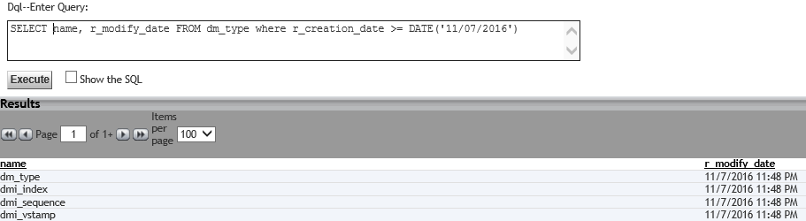
The following example returns the types that were last created in dates greater than or equal to the date specified.

Slide 29
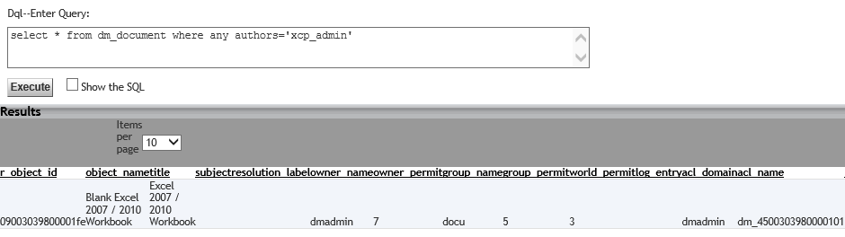
WHERE Clause for repeating properties
To search a repeating property for a specific value, use the ANY predicate in the WHERE clause qualification.
The following example searches the authors property to return any document that has xcp_admin as one of its authors:
  SELECT object_name FROM dm_document
  WHERE ANY authors = ‘xcp_admin’

Slide 30
DQL related to Registered Table
Register statement registers an RDBMS table so the content server can access it.
Allows access to data in an existing RDBMS table that may be:
    Created to support additional application data
    Part of another application.
    Owned by different owner.
    Does not verify that the table or its columns exist.
All columns in a table need not be registered.
Creates a dm_registered object in the system cabinet which provides a description of the table and user access to it.
Below Query registers a table from the underlying RDBMS with the repository.
Syntax
  REGISTER TABLE [owner_name.]table_name (column_def {,column_def}) [[WITH] KEY (column_list)] [SYNONYM [FOR] 'table_identification']

Slide 31

REGISTER permissions
Only the Docbase owner with SUPERUSER privilege can register a table within Documentum
To register a table, user must have at least READ permission on the table (through the RDBMS grant command).
The Content Server account (installation owner) needs the appropriate RDBMS privileges on the table to perform different operations on rows in the table.
REGISTER Table : Select

Slide 32
Specify owner name of the table if you do not own it
- use alias dm_dbo if the owner of the table is the Docbase owner
Insert, Update and Delete values from Registered Tables :
  insert into owner_name.table_name[(column_name{,column_name})] values (value{,value})| dql_subselect
  update table owner_name.table_name set column_assignments where qualification
  delete from owner_name.table_name where qualification

Slide 33
Test your understanding
This Query Returns
      A list of object names, authors, owners and content type for all documents (all versions) in the repository
      A list of object names, authors, owners and content type for all documents (Current versions) in the repository
      No results, there is an error in the query
select object_name, authors, owner_name, a_content_type from dm_document order by 3
Answer B

Slide 34
Test your understanding
2. This Query Returns
      A list of object id, object name, owner name and creation date for documents created between 01st Jan and 28th Feb.
      A list of object id, object name, owner name and creation date for documents created between 01st Jan and 28th Feb and also documents created on Jan 01st and Feb 28th .
      A list of object id, object name, owner name and creation date for documents created between 01st Jan and 28th Feb and also documents created on Jan 01st
      No results, there is an error in the query
select r_object_id,object_name,owner_name,r_creation_date from dm_document where r_creation_date < DATE('02/28/2018') and r_creation_date > DATE('01/01/2018')
Answer C

Slide 35
Hands On
Frame DQL query to return document name, owner name and document format for all versions.
Frame DQL query to get maximum size of a document in the repository
Frame DQL query to get list of process id’s and names which is in installed state
Frame DQL query to run the job.
Frame DQL to find the workflow details from the document attached to it.

Slide 36
Introduction to API

Slide 37
Introduction to API
API’s are Documentum Application Programming Interface
API commands, also referred to as Server API, are instructions or commands sent by clients to Content Server through DMCL.
API commands work on one object at a time to query its properties and do modifications to objects in the repository.
API commands used for system troubleshooting and administration/monitoring purposes.

Slide 38
API Tester in DA

Slide 39
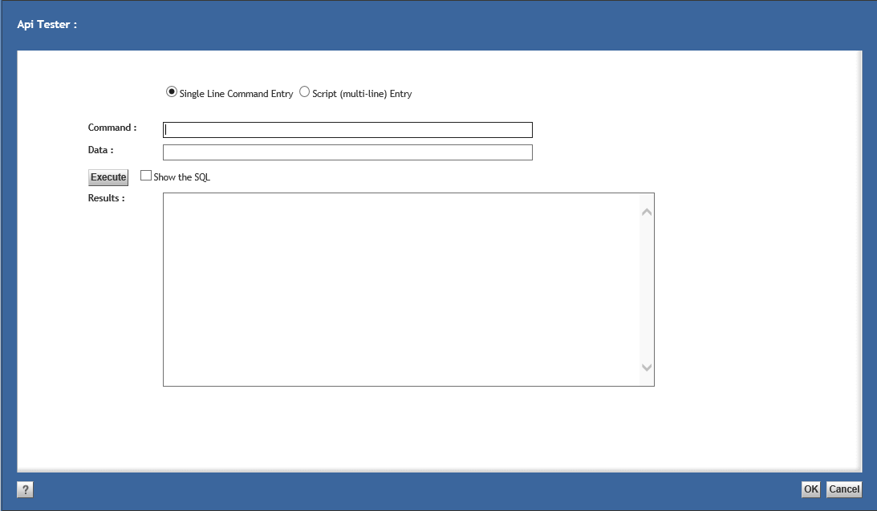
API Tester

Slide 40
API Methods
Below are few of API Server Methods:
  Methods for communicating with server
  Methods for handling objects
  Methods for searching the repository
  Methods for handling content objects
  Methods for handling workflows
  Note : Identifier ‘C’ in the API Commands represent current session.
  Similarly ‘L’ represents the r_object_id (last used) .

Slide 41
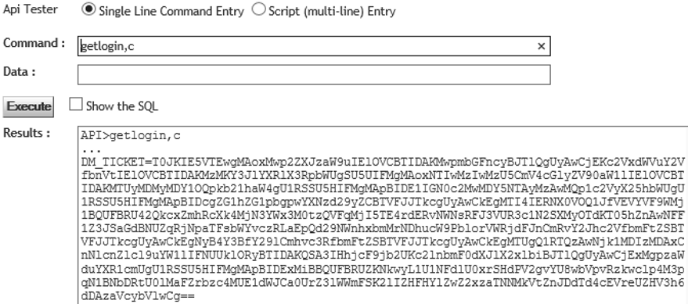
Methods for communicating with server
Method | Description | API Command
Abort | Cancels all changes made in an open explicit database transaction. | abort,c /abort,session
Begintran | Opens an explicit database transaction. | begintran,c
Commit | Saves changes made during an explicit database transaction and closes the transaction. | commit,c
Disconnect | Disconnects a session. | disconnect,c
Getlogin | Obtains a ticket that an application can substitute for the current user’s password as an argument to the Connect method. | getlogin,c

Slide 42
Methods for handling objects
Method | Description | Command
Checkin | Creates and saves a new version of a checked-out object. | checkin,c,r_object_id
Checkout | Checks an object out of the repository and places a lock on the object. | checkout,c,r_object_id
Promote | Promotes an object from its current normal lifecycle state to the next normal state. | promote,c,r_object_id
Demote | Demotes an object from its current normal lifecycle state to the previous normal state. | demote,c,r_object_id
Destroy | Removes an object from the repository. | destroy,c,r_object_id
Dump | Returns all attribute names and values or data dictionary information for an object. | dump,c,r_object_id
Fetch | Retrieves an object from the repository but does not place a lock on the object. | fetch,c,r_object_id
Freeze | Marks an object as unchangeable. | freeze,c,r_object_id
Unfreeze | Unlinks an object from a folder or cabinet. | unfreeze,c,r_object_id

Slide 43
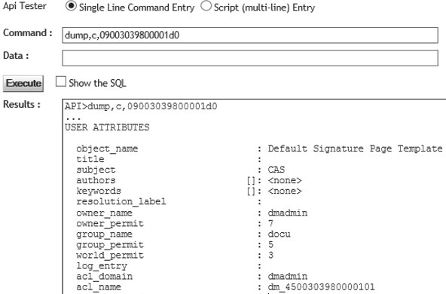
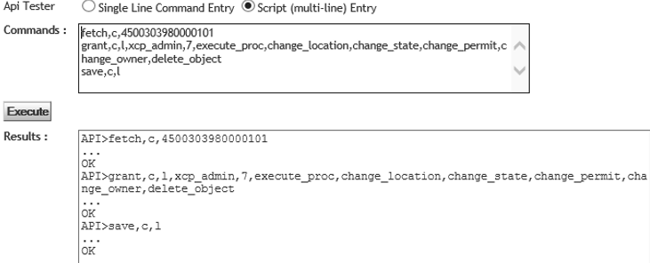
Method | Description | Command
Link | Links an object to a particular folder or cabinet. | link,c,r_object_id,folder_path
Unlink | Unlinks an object from a folder or cabinet. | unlink,c,r_object_id,folder_path
Save | Saves an object, overwriting the object currently in the repository. | save,c,r_object_id / save,c,l

Slide 44
Methods for searching the repository
Method | Description | Command
Execquery | Executes a DQL statement longer than 255 characters | execquery,session, [readquery_flag],dql_query
Execsql | Executes any SQL statement except a SELECT statement | execsql,session,sql_statement
Query | Executes a DQL query and returns the identifier for the resulting collection. The method allows you to modify data in the repository during query result processing. | query,session,dql_query

Slide 45
Methods for handling content objects
Method | Description | Command
Getcontent | Retrieves a content file from the repository and places it in working memory. | getcontent,session,object_id
Getfile | Returns the name of the file containing content in a particular format. | getfile,session,object_id
Getpath | Returns the internal path specification to a content file. | getpath,session,object_id
Removecontent | Removes content from an object. | removecontent,session,object_id
Setcontent | Sets data in working memory as new content or uses it to replace content. | setcontent,session,object_id] [,format[,page_number][,length][,set_resource]","content”

Slide 46
Methods for handling workows
Method | Description | Command
Abort | Aborts a workflow. | abort,c,workflow_id
Execute | Starts a workflow. | execute,c,workflow_id
Halt | Halts a workflow or activity. | halt,c,workflow_id
Restart | Restarts a halted workflow or activity. | restart,c,workflow_id
Setoutput | Defines the output port for manual transition of a work item. | setoutput,session,workitem_id{,output_port_name}
API TO COMPLETE THE PAUSED AUTO-ACTIVITY
restart,c,workflow_id,act seq no
setoutput,c,workitem_id,Output:0
complete,c,workitem_id

Slide 47
Test your understanding
Fetch,c,<r_object_id>
Set,c,l,object_name
<name to be set>
Above API Command will set object name for an object and the object name will save in repository?
          Yes
          No
Name the API commands to get the property of an object and Command to delete the object from the repository?
What is the significance of identifiers “C” and “L” in the API Commands?
Answers
B
Dump & Destroy

Slide 48
Hands On
Delete the running workflow using API Command.
Set object name for a document.
API command to unlock the document
API command to get all the properties of an object.
Execute DQL query using API command

Slide 49
Utilities
These utilities are used to perform small tasks in the repository and also to execute the scripts to perform action on repository objects.
Types of Utilities
  IDQL
  IAPI

Slide 50
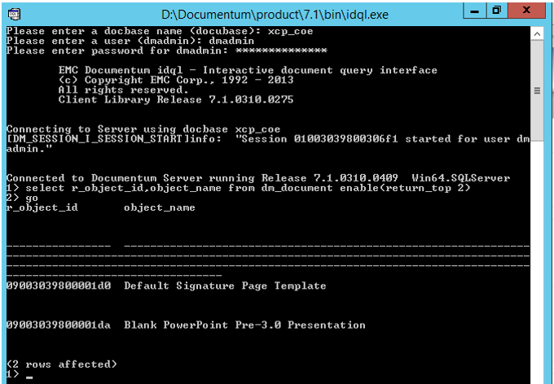
iDQL
iDQL – Interactive Document Query Interface
The IDQL utility is an interactive tool that lets you enter ad hoc DQL queries against a repository.
IDQL is included and installed with Content Server. It is found in %DM_HOME%\bin ($DM_HOME/bin).
Copy iDQL.exe along with DMCL to your local machine and start working on DQL’s

Slide 51
iDQL Commands
Command | Description
go | Executes a DQL statement and clears the query buffer.
clear | Clears the query buffer.
quit | Exits the utility.
describe | Provides a description of a specified object type or registered table. The syntax formats for this command are: describe [type] type_name describe table table_name
@scriptfile | Executes the specified script.
shutdown | Issues a Shutdown method that shuts down the Content Server gracefully. You must be a superuser or system administrator to use this command. When shutdown is complete, the utility exits.

Slide 52
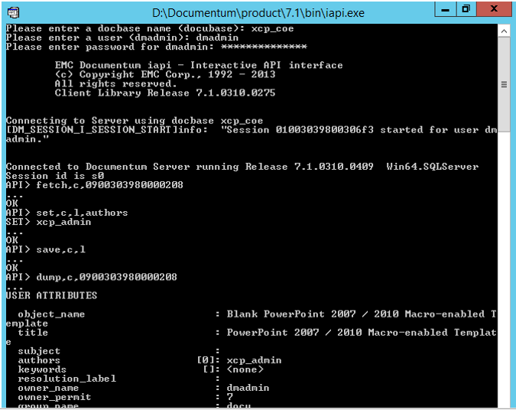
iAPI
iAPI – Interactive API Interface
The IAPI utility is a tool that you can use to execute API Commands.
This utility is included and installed with Content Server. It is found in %DM_HOME%\bin ($DM_HOME/bin).
Depending on your operating system, there may be multiple IAPI utilities.

Slide 53
iAPI Commands
Command | Description
$logfile | Outputs to the specified file
@scriptfile | Reads input from the specified file
%scriptfile | Outputs a script

Slide 54
Tools
The languages provided by Documentum DQL and API offers many ways to administer the Documentum Content Server, maintain and program.
External tools like dqMan and Samson provides user interface to execute the queries/commands and see the results.
dqMan is a program that allows you to use the DQL and API languages via an integrated interface.
It allows you to browse files in the API Command Area, it has support for DQL Command Message Area or you can use a vast variety of predefined functions to process the query results, like an inline editor, copy, export to CSV or Excel.

Slide 55
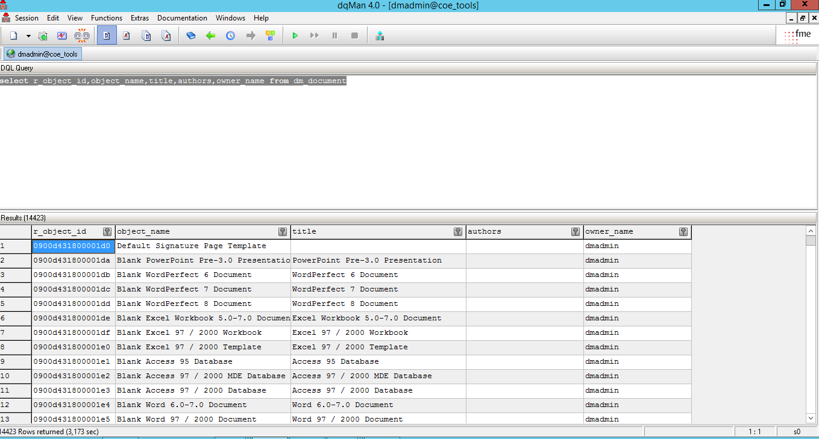
DQL Editor in dqMan

Slide 56
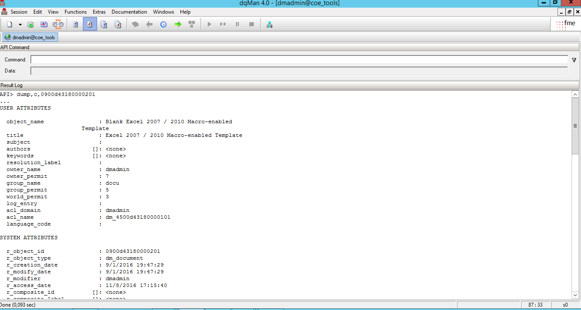
API Editor in dqMan

Slide 57
References
http://www.howmuchinformation.org/collateral/TechnicalDocument/docu57858.pdf
http://www.securant.com/collateral/TechnicalDocument/docu57864.pdf
http://www.jouvinio.net/wiki/images/4/48/Documentum_Content_Server_53_SP1_api_ref.pdf

Slide 58
  You have successfully completed
  DQL and API
Notes:
Place the audio notes for this slide here

